Slide 1
Life Science
Name of Institution
Date

Slide 2
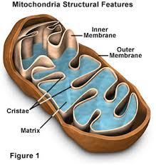
Mitochondria
There is an outer and inner membrane
The matrix and cristae exists inside the cell
The cristae are elongated within the cytoplasm
Most energy gets generated in the cell

Slide 3
Mitochondria Cont’
Mitochondria has a sausage shape but their sizes and shape differs in various cells.
It has a distinctive appearance when viewed using a microscope.
Mitochondria generates chemical energy that get required to power the cells biochemical energy (Miettinen, & Björklund, 2017).
Chemical energy in mitochondria gets stored in adenosine triphosphate (ATP).

Slide 4
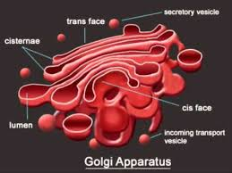
Golgi Apparatus
There is lumen and cisternae within the structure.
Secretory vesicle is where proteins gets released.
Incoming transport vesicle forms the parts of moving proteins.
There exists trans and cis face in Golgi apparatus.

Slide 5
Golgi Apparatus Cont’
It is a membrane bound organelle and contains clearly defined nucleus.
It is made up of a series of flattened stacked pouches called cisternae.
It is located in the cytoplasm (Barlow Et al 2018).
They helps in transporting, modifying and packaging of the lipids and proteins.
Plays a key role in the secretion of proteins.

Slide 6
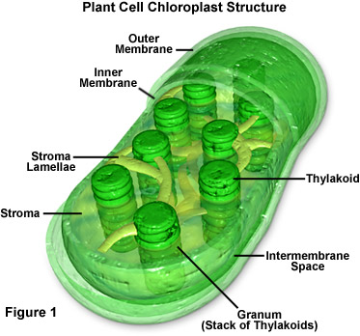
Chloroplast
Stacks of thylakoids form granum in the stroma
Inter membrane space exists between inner and outer membrane.
There is existence of stroma lamellae.
Thylakoids exists in the space in the cell.

Slide 7
Chloroplast cont’
It has got inner and outer membrane with an intermediate space in between the two.
It contains stacks of thylakoid called grana and a dense fluid called stroma.
Thylakoid contain chlorophyll used fro trapping light.
They help in converting light energy into stable chemical energy through photosynthesis (Kirchhoff, 2019).
Thylakoids temporarily store chemical energy to get used for photosynthesis.

Slide 8
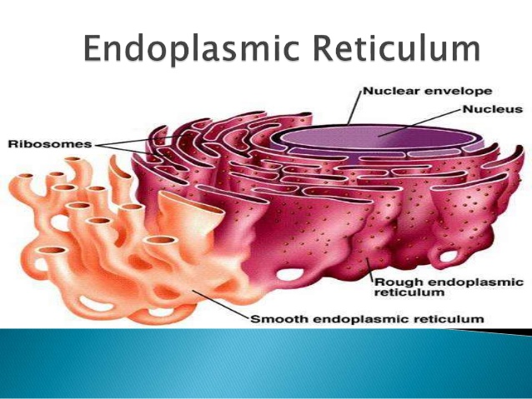
Endoplasmic Reticulum
Ribosomes exist on elongated structures within endoplasmic reticulum
There is a nuclear envelop that encloses nucleus of the cell
Smooth endoplasmic reticulum exists on one side different from rough endoplasmic reticulum.

Slide 9
Endoplasmic Reticulum
It contains a network of structures called cisternae.
Cisternae are held together by cytoskeleton.
Phospholipid membrane encloses lumen in the perinuclear space.
They help in synthesis, folding, modification and transportation of proteins.
They consist of two types; smooth and rough endoplasmic reticulum.

Slide 10
References
Barlow, L. D., Nývltová, E., Aguilar, M., Tachezy, J., & Dacks, J. B. (2018). A sophisticated, differentiated Golgi in the ancestor of eukaryotes. BMC biology, 16(1), 1-15.
Kirchhoff, H. (2019). Chloroplast ultrastructure in plants. New Phytologist, 223(2), 565-574.
Miettinen, T. P., & Björklund, M. (2017). Mitochondrial function and cell size: an allometric relationship. Trends in Cell biology, 27(6), 393-402.

